Slide 1
P2P ChatSDK with distributed hashtables
Masterproject
Benedikt Kaiser

Slide 2
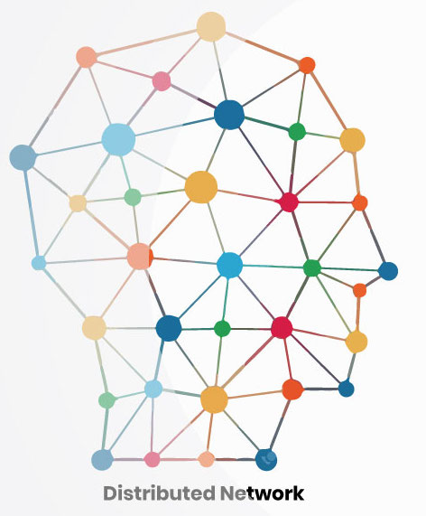
Vision
Distributed internet
Privacy
No more sold data
https://www.btcwires.com/glossary/distributed-network/

Slide 3

Solution
P2P ChatSDK with distributed hash tables als Masterarbeit
Serverlos
ChatSDK for iOS
Notes:
Serverlos, nicht so wie zB bei Matrix, wo man trotzdem daheim noch seinen node benötigt

Slide 4
Master thesis
2nd semestre:
literature research
iOS app for testing the udp connection
3rd semestre:
Implementing distributed hash table
Testing & optimizing
4th semestre:
Evaluation technology
Writing master thesis

Slide 5

Main problems
Person A
Person B

Slide 6
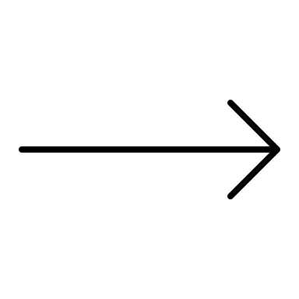

Main problems
Person A
Person B

Slide 7
Main problems
How can person b be reached?
Person A
Person B
IP address
Email address
Telephon nr.

Slide 8
Main problems
How can person b be reached?
Person A
Person B
IP address
Email address
Telephon nr.
How do we get the ip address?

Slide 9

Main problems
Conventional structure
Person A
Server
Person B
Fixed ip

Slide 10
Main problems
Conventional structure
Person A
Server
Person B
Fixed ip

Slide 11
Main problems
Conventional structure
Person A
Server
Person B
Push message (APNs)
Device ID

Slide 12
Main problems
How can person b be reached?
Person A
Person B
IP address
How do we get the ip address?

Slide 13

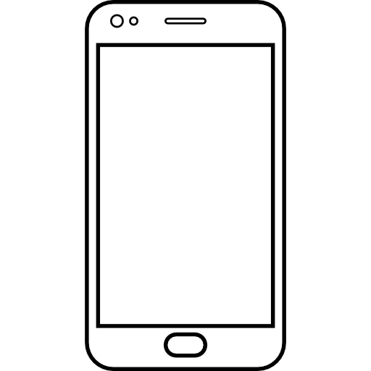
Answer: Distributed hash tables
Data
Key
Benedikt Kaiser
Hash function
FC65B3D
FC65B3D | 10.3.106.97:1337

Slide 14
Answer: Distributed hash tables
Data
Key
Benedikt Kaiser
Hash function
FC65B3D
Tobias Wagner
Hash function
A195CC2
Thomas Sickinger
Hash function
231BCD3

Slide 15
Routing table
FC65B3D | 10.3.106.97:1337
2E5BF1D | 10.3.106.97:1347
37HF21A | 10.3.106.97:1317
New nodes get added
Unresponsive nodes get removed

Slide 16
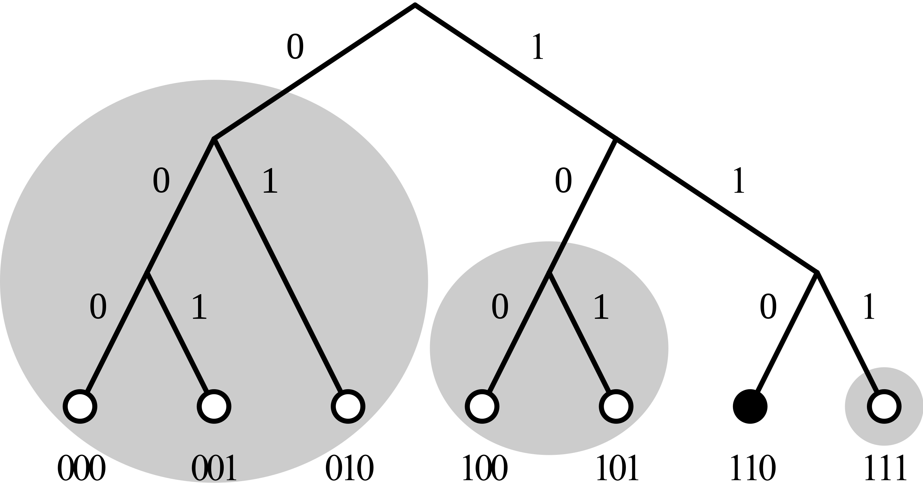
Distance between nodes
How similair are two nodes?
Xor metric
https://en.wikipedia.org/wiki/Kademlia#/media/File:Dht_example_SVG.svg

Slide 17
Joining a network
How do I know the IP-Adress of anyone in a network?
WebRTC’s Perfect Negotiation
Define an interface
Programmer who uses SDK needs to decide

Slide 18
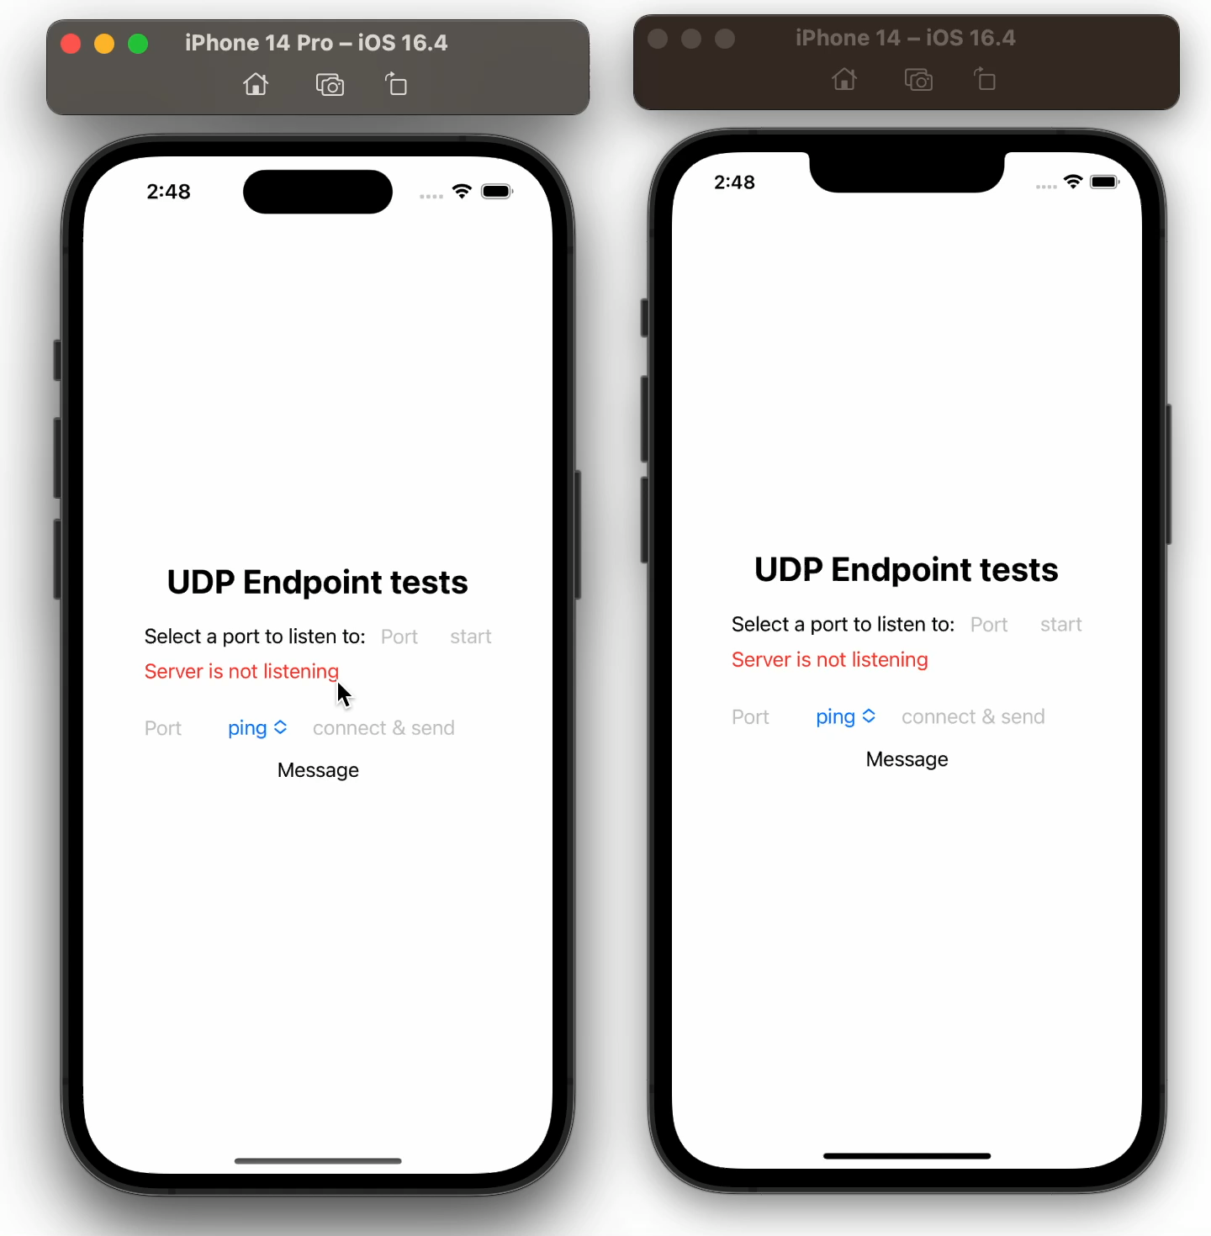
iOS test app
Tests a udp connection

Slide 19


iOS test app - difficulties
UDP socket
Background tasks in iOS

Slide 20
Thanks for the attention

